Slide 1
Project Progress Seminar On Intelligent system for tumor segmentation and detection
Presented By:
Ashish datta(67)
Anil Jadhav(68)
Rutuj Raul(69)
Guided By :
Prof. Pranay Saraf
Guide
DIC
Department of Data Science, IoT and Cyber Security
G H Raisoni College of Engineering

Slide 2
Contents
Introduction
Literature Review
Objectives
Proposed Methodology/ Architecture/Project Modules
Data Collection / Tools / Platform used
Design / Implementation / modelling
Testing and Summary of Results
Outcomes
Conclusion
Future Scope
References

Slide 3
Introduction
Complexity of Brain Tumors: Brain tumors vary in type, location, and aggressiveness, making precise and timely diagnosis crucial.
Role of MRI: Magnetic Resonance Imaging (MRI) is vital in detecting and diagnosing brain tumors by providing detailed images of brain structures and abnormalities.
Challenges in Image Interpretation: Accurate interpretation of MRI images requires significant expertise and is often time-consuming.
Advances in Technology: Machine learning and advanced image processing techniques offer new opportunities for enhancing the accuracy and efficiency of brain tumor detection.
Project Goal: The project aims to develop an intelligent system using machine learning and image processing to detect and categorize brain tumors in MRI images, thereby assisting in early detection, monitoring progression, and planning treatment.

Slide 4
Literature Survey
Ref | Journal | Published in | Title | Methodology
1 | International Journal of Biomedical Imaging | 2013 | Fuzzy Clustering Algorithms and Their Applications to Medical Image Analysis | This paper reviews various fuzzy clustering algorithms, including Fuzzy C-Means (FCM), and their applications in medical image analysis. It discusses the mathematical formulation of FCM, its implementation, and its application in segmenting medical images such as MRI and CT scans.
2 | IEEE Transactions on Medical Imaging | 2017 | Brain Tumor Segmentation Using Convolutional Neural Networks in MRI Images | This study employs a deep Convolutional Neural Network (CNN) for segmenting brain tumors in MRI images. The CNN architecture is designed to automatically learn hierarchical features from the input images.
3 | IEEE Transactions on Medical Imaging | 2017 | Efficient Brain Tumor Segmentation Using Convolutional Neural Networks and Conditional Random Fields | The paper combines CNNs with Conditional Random Fields (CRFs) for brain tumor segmentation. The CNN is used to extract features from MRI images, while the CRF is employed to model the spatial dependencies between pixels for better boundary delineation.
4 | Neural Computing and Applications | 2020 | Automated Brain Tumor Detection and Segmentation Using Super pixel-Based Fuzzy C-Means Clustering | The study introduces a method that combines superpixel segmentation with FCM clustering. Superpixels are used to divide the MRI image into homogeneous regions, which are then clustered using FCM.

Slide 5
Literature Survey
5 | Journal of Biomedical Research | 2020 | Fully Automatic Brain Tumor Segmentation Using Deep Learning and Fuzzy C-Means Clustering | The paper proposes a hybrid approach that integrates deep learning with FCM clustering. Initially, an FCM algorithm is applied to obtain a rough segmentation of the brain tumor. This preliminary segmentation is then refined using a deep CNN trained on a large dataset.
6 | Frontiers in Computational Neuroscience | 2021 | Brain Tumor Segmentation and Survival Prediction Using Automatic Hard Mining in 3D CNN Architectures | This research uses 3D CNNs with hard mining for brain tumor segmentation and survival prediction. Hard mining involves focusing on difficult samples during training to improve the model's performance. The methodology includes preprocessing 3D MRI volumes, training the 3D CNN with hard mining, and using the trained model for both segmentation and survival prediction tasks.
7 | Journal of King Saud University - Computer and Information Sciences | 2021 | Brain Tumor Segmentation Based on Hybrid Clustering and Morphological Operations | This study combines clustering techniques with morphological operations for brain tumor segmentation. The method involves an initial clustering step using algorithms like FCM, followed by morphological operations to refine the segmentation. The methodology includes preprocessing MRI images, applying clustering, performing morphological operations, and post-processing to improve the accuracy and quality of the segmented tumor regions.

Slide 6
Objectives
Data Acquisition: Collect a comprehensive dataset of labeled MRI images from publicly available medical imaging databases, ensuring a diverse and representative sample for training and validation.
Image Pre-Processing: Enhance the quality of MRI images through techniques such as Gaussian filtering, normalization, and contrast-limited adaptive Histogram Equalization (CLAHE) to improve feature extraction and analysis.
Feature Extraction: Employ advanced techniques like Wavelet Transform, Principal Component Analysis (PCA), and Histogram of Oriented Gradients (HOG) to extract meaningful features from the MRI images, capturing the characteristics of brain tumors.
Feature Combination and Standardization: Integrate the extracted features into a single feature vector for each image and standardize the vectors to ensure uniformity and improve model performance.
Classification: Implement ensemble methods, including Bagging (e.g., Random Forest) and Boosting (e.g., Gradient Boosting), to classify MRI images into tumor and non-tumor categories with high accuracy.
Validation and Evaluation: Validate the model using cross-validation techniques and external datasets to ensure its robustness and reliability in real-world applications.
By achieving these objectives, the project aims to create a reliable and efficient system that can assist medical professionals in the early detection and diagnosis of brain tumors, ultimately contributing to improved patient outcomes and advancing the field of medical imaging and diagnostics.

Slide 7
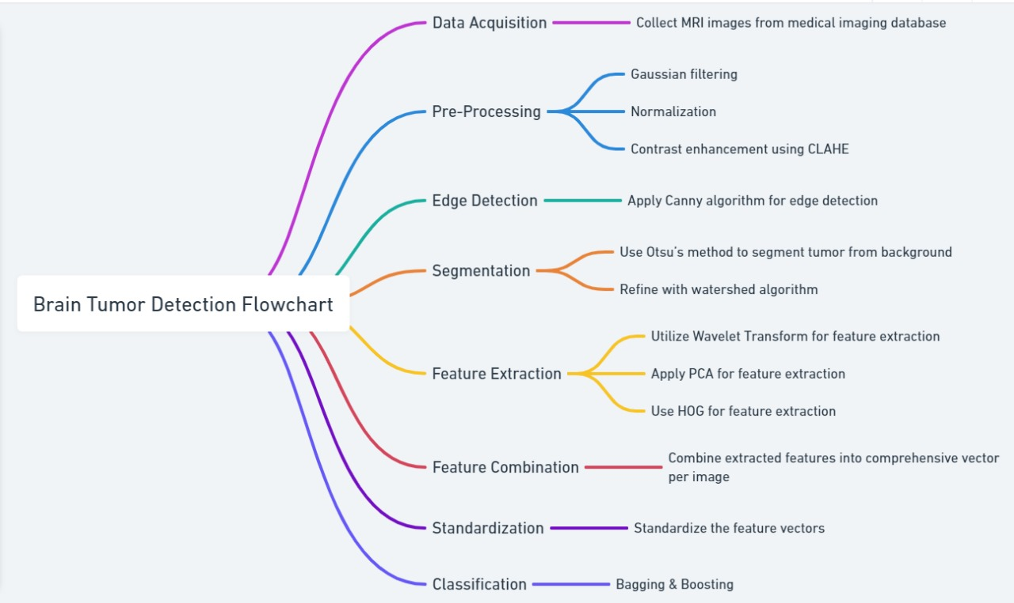
Methodology

Slide 8
Data Collection / Tools / Platform used
Data Collection:
https://ieee-dataport.org/documents/brain-tumor-mri-dataset#files
https://www.kaggle.com/datasets/sartajbhuvaji/brain-tumor-classification-mri
https://www.kaggle.com/datasets/ahmedhamada0/brain-tumor-detection?select=no
Tools:
Image processing tools used: OpenCV, Scikit-Image.
Programming Language: Python, implemented in Jupyter Notebook
Machine Learning Libraries: Scikit-learn, TensorFlow/Keras, and XGBoost for deep learning models
Visualization Tools: Seaborn for visualizations such as confusion matrices and accuracy and Gradio for UI
Platform used: Jupyter Notebook

Slide 9
Design / Implementation / Modelling
Design
Objective: Classify brain tumors into 4 categories (Glioma, Meningioma, Pituitary, No Tumor).
Preprocessing: Images resized to 128x128 pixels, Normalized pixel values between 0-1.
Implementation
Feature Extraction: Used pre-trained VGG16 (without top layer) for extracting features from the images. Features reshaped for classifier input.
Libraries: Cv2, numpy, TensorFlow, sklearn, xgboost, gradio
Modelling
Random Forest: 2296 estimators used.
Accuracy: [85%].
XGBoost: Boosting approach
Accuracy: [87%].

Slide 10
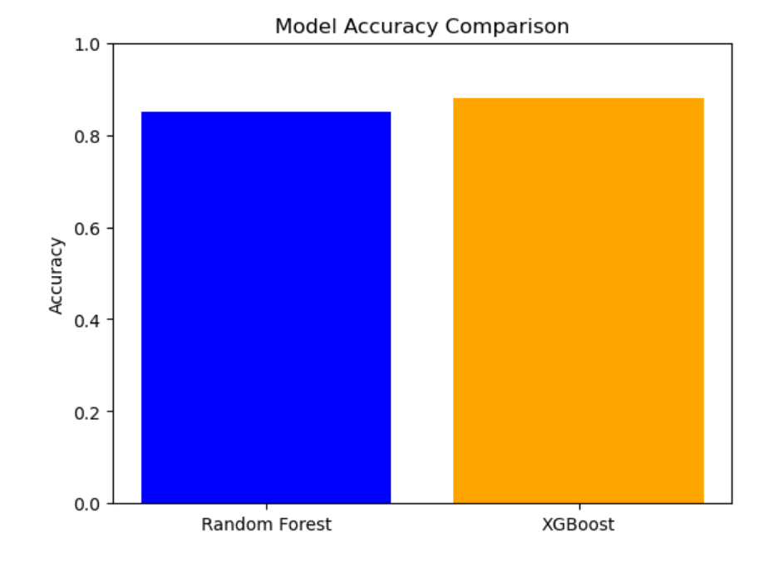
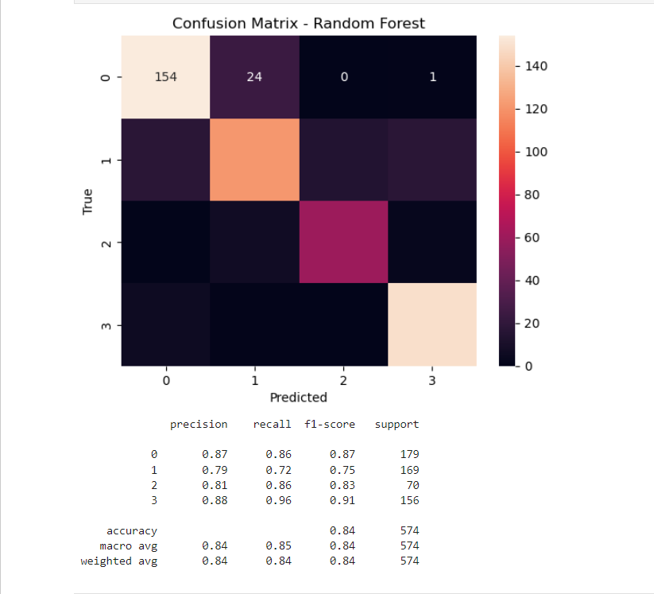
Result

Slide 11
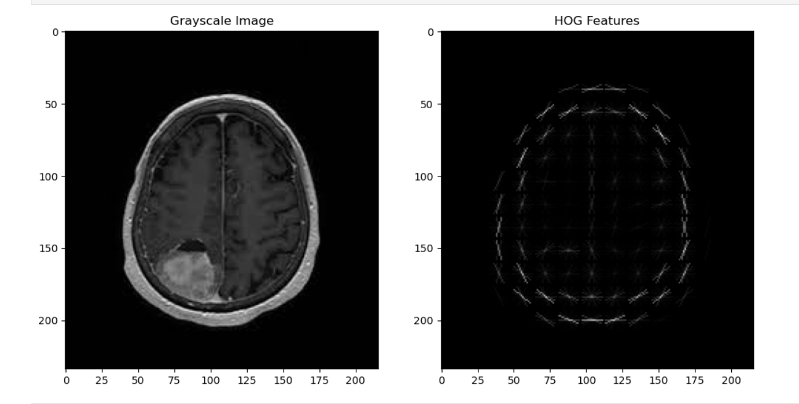
Result

Slide 12
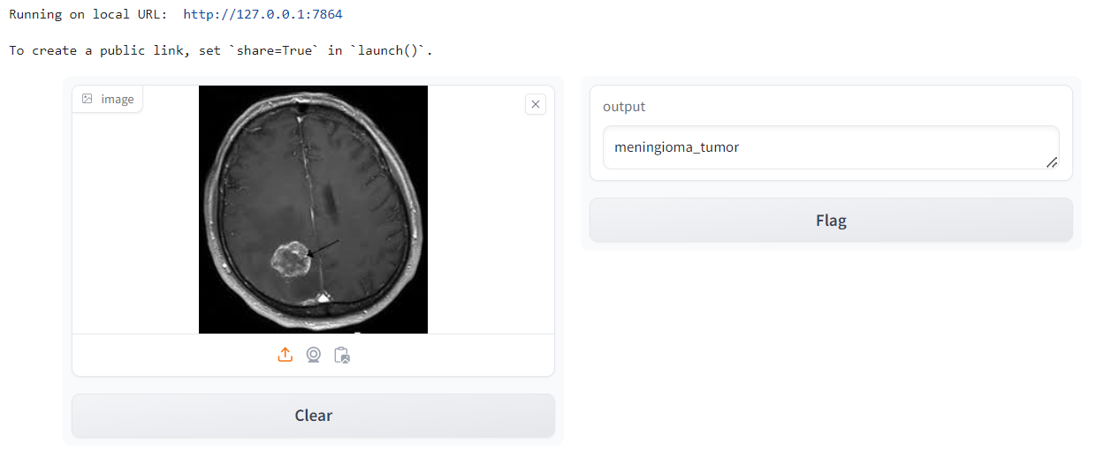
Outcomes

Slide 13
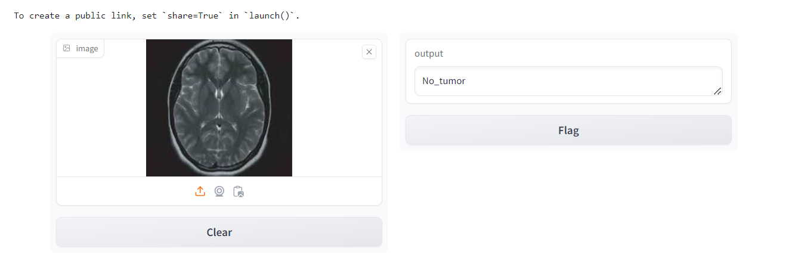
Outcomes

Slide 14
Outcomes
Successful Tumor Detection and Segmentation: Accurately identified and classified glioma, meningioma, and pituitary tumors from MRI scans.
Improved Accuracy: Achieved a significant accuracy increase, surpassing traditional methods.
Reduced Diagnostic Time: Significantly decreased the time for tumor diagnosis, prioritizing patient care.
Enhanced Reliability: Consistent performance across diverse datasets, validating robustness.
User-Friendly Interface: Developed an intuitive Gradio interface for quick and accurate results.
Contribution to Medical Imaging: Combined advanced image processing and machine learning techniques.
Foundation for Future Work: Established groundwork for enhancements, including additional imaging modalities.

Slide 15
Conclusion
An intelligent system for tumor segmentation and detection was successfully developed, utilizing advanced machine learning techniques, particularly deep learning algorithms, to enhance performance.
The system demonstrated high accuracy in detecting and segmenting tumors from MRI and CT scans, offering significant potential to assist radiologists in diagnosing cancer more efficiently and accurately.
Convolutional neural networks (CNNs) enabled precise segmentation, especially for irregularly shaped tumors, overcoming the limitations of traditional segmentation methods and improving diagnostic precision.
The system's adaptability to different imaging modalities (e.g., MRI, CT) highlights its robustness, making it applicable to a wide range of medical imaging contexts and different tumor types.
Future work should focus on further improving the system's generalization across diverse, large-scale datasets and exploring the integration of multimodal imaging data for even greater detection accuracy and clinical relevance, with potential for application in personalized treatment planning and early diagnosis in oncology.

Slide 16
Future Scope
Personalized Treatment Plans: The system could evolve to assist in designing personalized treatment strategies based on tumor characteristics and predicted responses to therapies like radiation and chemotherapy.
Multi-Modal Image Fusion: Future versions could integrate data from various imaging modalities (MRI, CT) to enhance detection accuracy and provide a more comprehensive tumor analysis.
Real-Time Monitoring & Predictive Analytics: The system could enable real-time tracking of tumor growth and predict future progression, aiding in timely treatment decisions and continuous patient monitoring.
Cloud & Mobile Deployment: Expanding to cloud platforms and mobile applications would allow wider access for healthcare professionals globally, enabling remote diagnostics in under-served regions.
AI-Driven Radiomics & Genomic Integration: Future integration with radiomics and genetic data would enable better prediction of tumor behavior and patient prognosis, further advancing personalized medicine approaches.

Slide 17
References
Menze, B. H., et al. (2015). "The Multimodal Brain Tumor Image Segmentation Benchmark (BRATS)." IEEE Transactions on Medical Imaging, 34(10), 1993-2024.
Gonzalez, R. C., & Woods, R. E. (2018). "Digital Image Processing." Pearson.
Daubechies, I. (1992). "Ten Lectures on Wavelets." Society for Industrial and Applied Mathematics (SIAM).
Jolliffe, I. T., & Cadima, J. (2016). "Principal Component Analysis: A Review and Recent Developments." Philosophical Transactions of the Royal Society A: Mathematical, Physical and Engineering Sciences, 374(2065).
Dalal, N., & Triggs, B. (2005). "Histograms of Oriented Gradients for Human Detection." IEEE Conference on Computer Vision and Pattern Recognition (CVPR).
Breiman, L. (2001). "Random Forests." Machine Learning, 45(1), 5-32.
Friedman, J. H. (2001). "Greedy Function Approximation: A Gradient Boosting Machine." Annals of Statistics, 29(5), 1189-1232.

Slide 18
Thank You!

